Slide 1
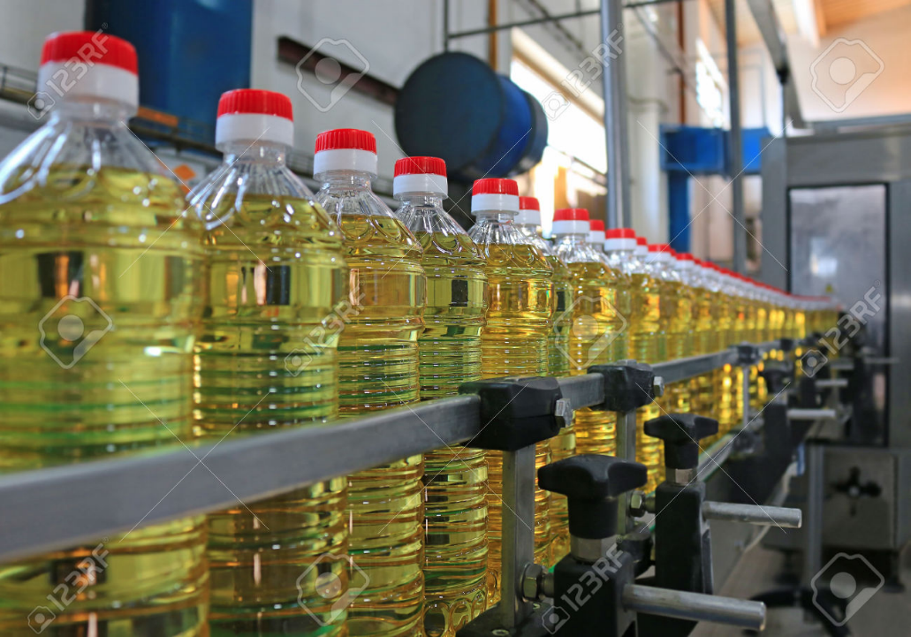
GDP: Gross Domestic Product
Meaning
Methods to Calculate: 3 book methods, 2 real methods of CSO
Demonetization: Effect?
Current price
Constant price
GDP deflator
Growth Rate
NNP
GNP

Slide 2


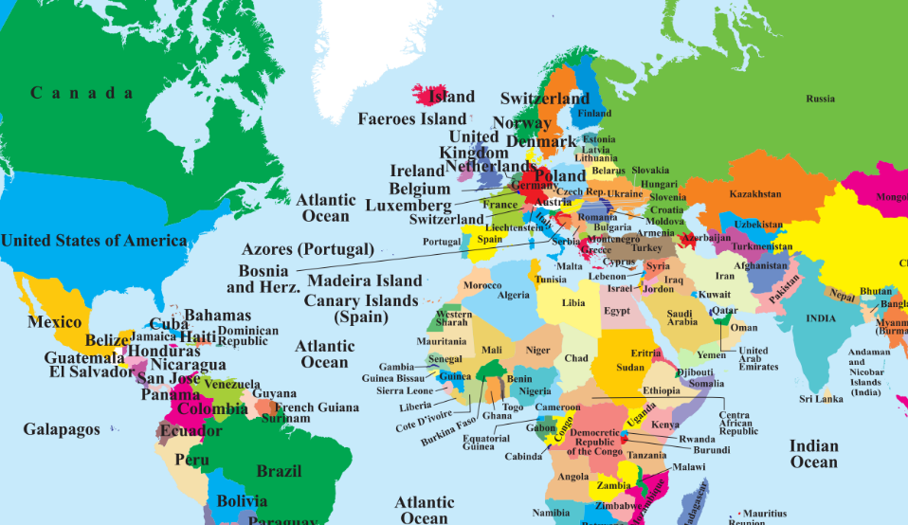



Gross Domestic Product (GDP) सकल घरेलू उत्पाद (2016)
Jaguar: 50k cars mfg.
Exploration: Rs.701 cr.
$68 million
++ Wages, Profit,
Interest, Dividend
++ Profit
Rs.100 cr (2014)
++ Remittance, gift, donation
GDP is the Market value of
All final goods & services
Produced within a country
For a given time period.
Rs.40 cr (2016)
-- Remittance

Slide 3
GDP calculation method #1= खर्चा, the Expenditure
Final Private Consumption (C)
Not intermediate goods like steel, rubber-> only final product (desi Nano + imported Ferrari also counted)
Existing House -> “rent” to yourself.
Investment (I)
New House purchase: No.
New House, building, capital goods/asset.
Intermediate goods for future production.
Capital from Share, Bond, Debenture – used in above activities
Because if something is ‘produced’, then
someone must have spent rupees to make it or buy it

Slide 4
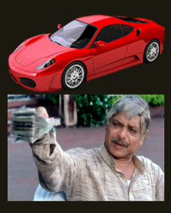
GDP calculation method #1: Consumption (C)+investment (I)
+Government “purchase” (G)
Salaries, Procurement yes
But, scholarship, Widow pension, Unemployment Allowance, “UBI(!)” etc. “Transfer Payments”..No Private final consumption (C)
+Foreigner spending in India (eXport-iMp)
-- imported Ferrari [private final consumption-walli, because it’s produced outside India]
+ Google paying call centre “service” + Arnold Buying Desi Nano
Because if something is ‘produced’, then
someone must have spent rupees to make it or buy it

Slide 5
GDP Calc: Expenditure method: GDP= C + I + G + (X – M)
+Consumption (Final)
+Government “Purchase”
Foreigner’s Expenditure Or NET Export
(eXport-iMport)
+Investment
GDP @Constant
market prices
Inflation price adjust with base year (2011)
GDP at Current Market Price

Slide 6
Mock Question for Prelims
If Government of India starts giving universal basic income to all of its citizens, where will it be counted in the Expenditure method of GDP calculation?
Government Expenditure (G)
Private consumption (C)
Investment (I)
All of above depending on recipient being a govt employee, private citizen or entrepreneur.

Slide 7
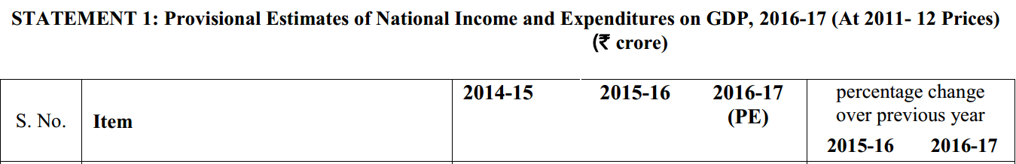
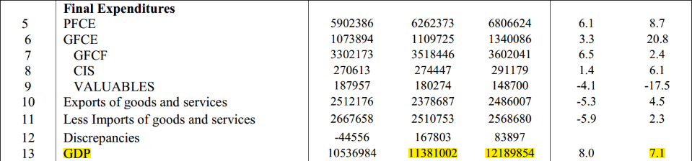

GDP calc. Expenditure method: Book formula-> Real CSO formula?
Will explain after a few slides
Only for information.
Else bookish formula “CIGXM” is sufficient.
Growth rate
over last year
PFCE: private final consumption Expenditure; GFCE: Government final consumption Expenditure
GFCF: gross fixed capital formation; CIS: change in stocks…. Then adjusted @base price (2011)

Slide 8
GDP Calculation: THREE Methods
Expenditure
C + I + G + (X – M)
Consumption, investment, Govt. purchase, Net export
Production: Gross Value Added (GVA)
Income Method (WIPR0)
W+I+P+R
Wages, interest, profit, rent
Total Value of Sale – Cost of intermediate goods
Notes:
In the National Accounts Statistics of India, the production approach GDP is considered firmer estimate; and the NAS presents the discrepancy with the expenditure approach GDP explicitly.

Slide 9
GDP calculation Method #1: Expenditure (CIGXM) Method#2: Gross Value Added (Production method)
Rs.00
Wage(W)
Rs.1 lakh
Wage(W)
Rs.5 lakh
Rs. 10 lakh
Final product
Interest(I)
Profit(P)
Rent(R)
Interest(I)
Profit(P)
Rent(R)
Wage(W)
Interest(I)
Profit(P)
Rent(R)
Intermediate Goods
Total Sale
Rs. 16 lakh
(-)Rs. 6 lakh Cost of intermediate goods
Value Addition
= Rs. 10 lakh GVA @basic price
1
5
4

Slide 10
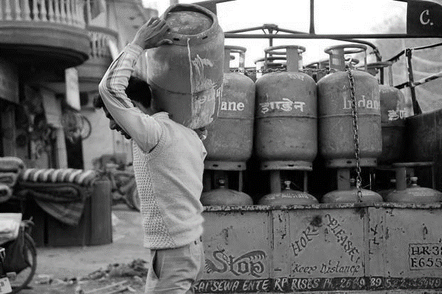
Suppose we only produce LPG? (hypothetical numbers)
Rs.600 GVA @Basic price
Rs. 700/- with tax
+Excise on mfg [CGST] + VAT on sale [SGST/ UT]
- Rs. 300 Subsidy
= Rs.400
LPG @Basic Rs. 600 per cylinder
PAHAL (DBT) Scheme, 2014, Petro Min.
Current Market Price [GDP]
Iron ore-> Steel ->Cylinder| [Gas->LPG]
GDP is the Market value of
All final goods & services
Produced within country
For a given time period.

Slide 11
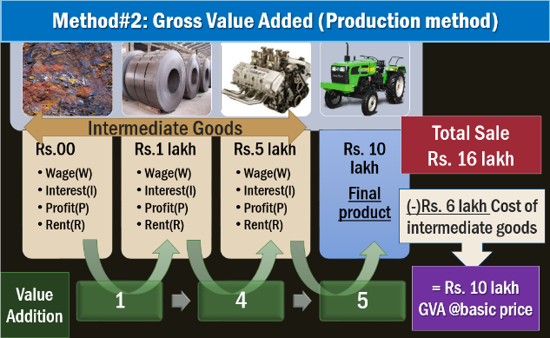

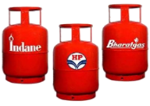
Officially, this method is considered firmer, more accurate than others. So if Expenditure method shows different GDP number= “discrepancy” in Expenditure method.
GDP @Constant
market prices
(official GDP)
∑ (GVA of all goods and services produced)
Inflation price adjust with base year
(2011)
Subsidies
Else simply say “+NET TAXES”
GDP @Current Market Price

Slide 12
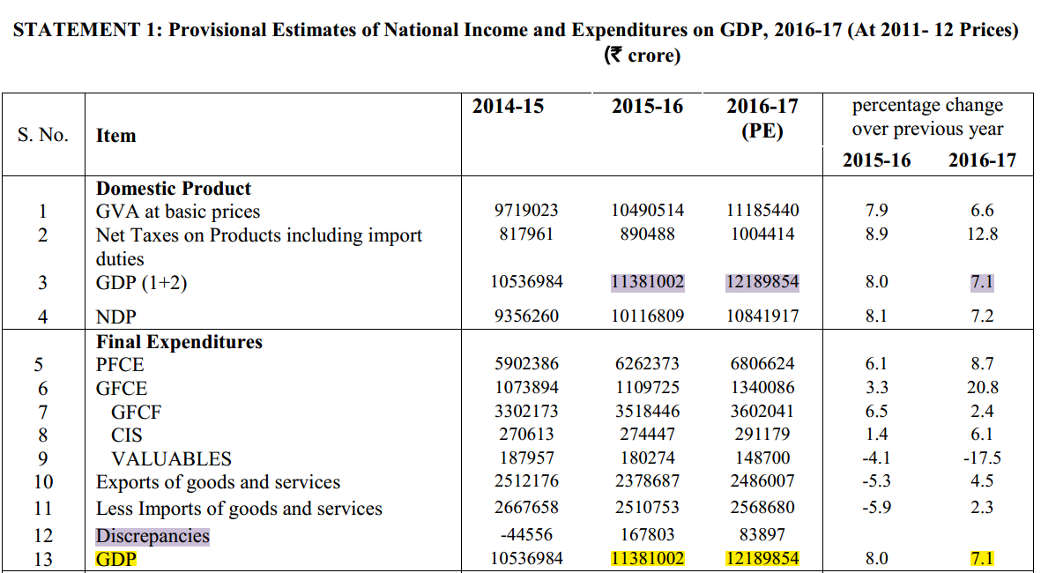
GDP calculation Method #2: Gross Value Added (GVA)
GDP calculation Method #1: Expenditure (CIGXM)
If Expenditure method shows different number, it’ll be adjusted by saying “Discrepancy”, because GVA method is like General Dong- it can never be ‘WRONG’.

Slide 13
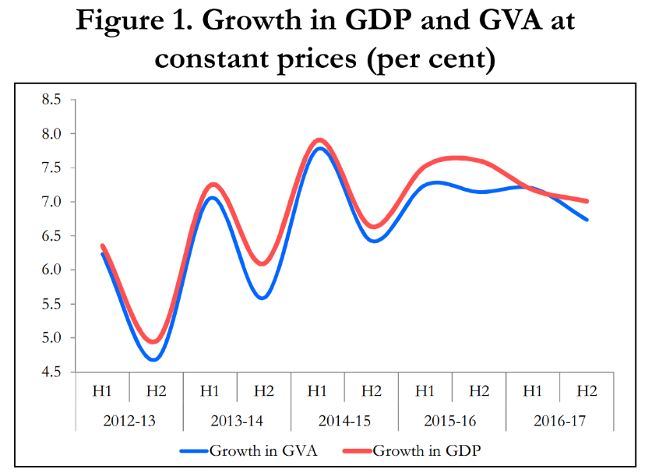
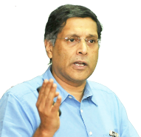
Why this wedge (gap)?
NET taxes (+tax minus subsidies)
Gap is less, because remember “Fiscal Stimulus” so tax breaks, loan subsidies more= wedge (gap) is low.
Only union budget 2017
+ 19.00 lakh cr (Direct indirect taxes)
2.72 lakh cr. Subsidies
= NET Tax will be a positive number! Hence GDP > GVA.
Taper Tantrum Crisis
First, I’ll give graph/table then I’ll read that graph and type all info in text AGAIN= that’s how I fill 300 pages of bol-bachchan Economy survey 2016-17. <wink wink>

Slide 14
Mock Question for Prelims
If a country’s GDP at market prices is lower than its gross value added (GVA) by each sector, then which of the following could be a possible explanation?
Presence of a large parallel black economy in urban areas and barter system in rural areas.
Economy could be undergoing a phase of recession.
Subsidies to GDP ratio could be higher than tax: GDP ratio.
None of the above.

Slide 15

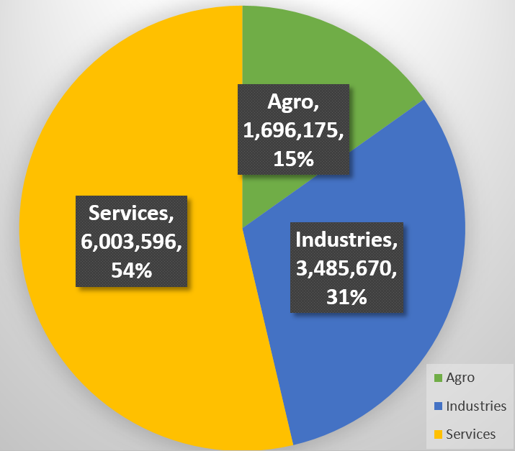


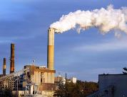
GVA contribution by each sector in 2016-17 (@2011, Constant prices)
Agriculture
Forestry
Fishing
mining & quarrying
manufacturing
electricity, gas, water supply & other utility “services”
construction
Trade, hotels, transport, communication & broadcasting
financial, real estate & professional services
Public Administration, defense & others
Amount in lakh crores. CSO, 31/5/17

Slide 16
Mock Question for Prelims
In CSO’s official classification of economic sectors, Which of the following are clubbed as ‘industries sector’?
Real estate.
Water supply and other utility services
Construction
Fishing.
Answer choices
(a) 3 only
(b) 2 and 3 only
(c) 1 and 3 only
(d) 1, 2, 3 and 4

Slide 17
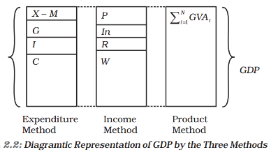
GDP Calculation: THREE Methods
Expenditure
C + I + G + (X – M)
Consumption, investment, Govt. purchase, Net export
Production: Gross Value Added (GVA)
Income Method (WIPR)
W+I+P+R
Wages, interest, profit, rent
Total Value of Sale – Cost of intermediate goods = GVA
+ Tax MINUS Subsidies = GDP @Current Price
Then adjust prices with base year = GDP @Constant price
Notes:
In the National Accounts Statistics of India, the production approach GDP is considered firmer estimate; and the NAS presents the discrepancy with the expenditure approach GDP explicitly.

Slide 18
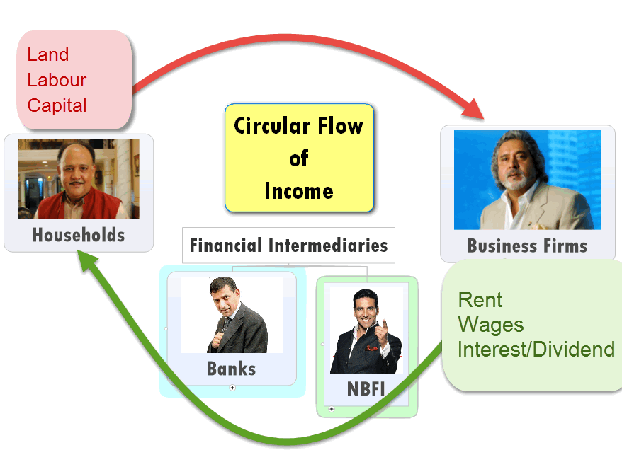

GDP Calc. Method #3: Income method
Sum of (WIPR “O”)
Factor
Income
Wages
Interest | dividend
Land/Building
Profit
Rent
Entrepreneur
Labor
Capital
Total= GDP @Factor Cost

Slide 19

@income method (FC)
=10 lakh
@GVA method (basic price) = 10 lakh
I can illustrate with a table and hypothetical numbers, But let’s just not waste time or mental energy on it.

Slide 20
Suppose we only produce LPG? (hypothetical numbers)
Rs.600 at factor cost
Rs. 700/- with tax
+Excise on mfg [CGST] + VAT on sale [SGST, UT]
- Rs. 300 Subsidy
= Rs.400
LPG @Factor cost Rs. 600 per cylinder (WIPR “O”)
PAHAL (DBT) Scheme, 2014, Petro Min.
Market Price
GDP is the Market value of
All final goods & services
Produced within country
For a given time period.

Slide 21
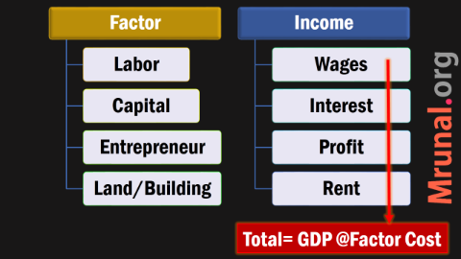

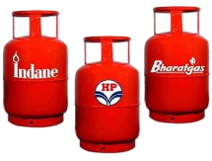
GDP @Constant
market prices
Inflation: adjust price with base year (2011)
Subsidies
GDP @Current Market Price

Slide 22
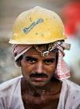






Book formula (WIPR) ←Income method→ CSO-Actual (2015)
Factor
Income
Wages
Profit
Interest
Rent on “assets”
Entrepreneur
Laborer
Capital
Land/Building
“Compensation”
salary+ Boss’ contribution to SS
Mixed income, operating surplus
Consumption of fixed assets during production.
GDP
@Factor Cost
GVA
@Factor Cost

Slide 23
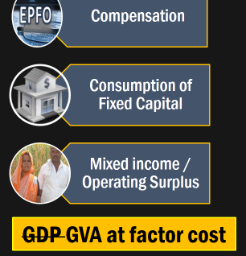

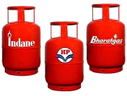
Independent of volume..
Professional Tax
Stamp Duty
Land revenue
Farmers: loan subsidy 3% irrespective of whether he produces 100kg or 1000 kg.
SSI, Railway Etc.
Production
Taxes
Production
Subsidies
CSO’s
Income Method
For
GDP computation
GDP GVA at Basic Price

Slide 24
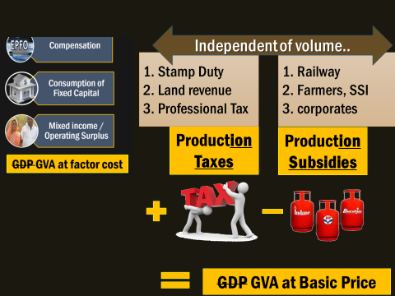
Dependent on production
VAT, Excise, Service,
Custom, GST
LPG-PAHAL
PDS-NSFA
Farmer-MSP
Product
Taxes
Product
Subsidies
∑Sum of
GVA @Basic prices
GDP at Market Price(MP)
GDP @constant prices [Official]
Inflation price adjust with
base year (2011)

Slide 25
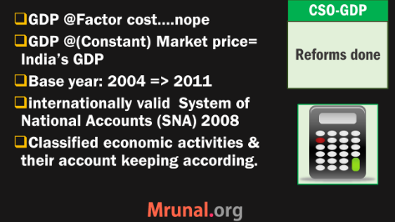
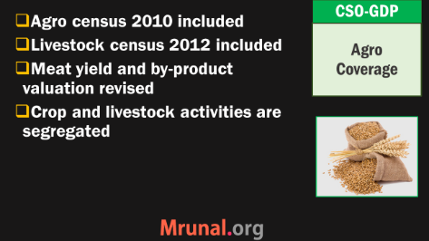
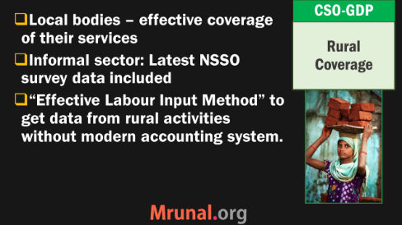
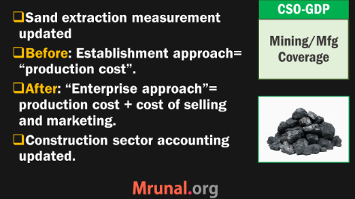
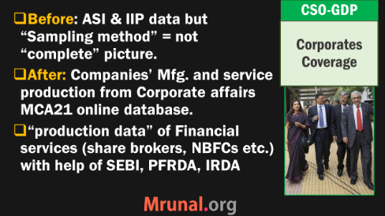
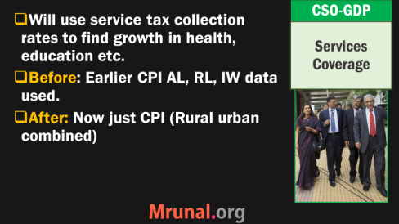
CSO: GDP Calculation reform (2015) not important

Slide 26
GDP: Gross Domestic Production
Meaning
3 Methods to Calculate
Demonetization: Effect?
Current price
Constant price
GDP deflator
Growth Rate
NNP
GNP

Slide 27

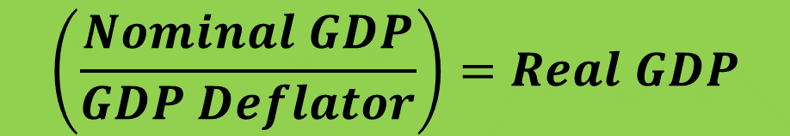
Base year: 2011
Constant Price
Rs.1 Lakh / car
Present year: 2017
Current Price
Rs.1.5 Lakh / car
Rs. 1L
Rs. 1L
Rs. 1L
Rs. 1L
Nominal GDP:
3 lakh @Current Price
Rs. 1L
x100
GDP: 3 lakh (2011)
Real GDP: 2 lakh
@Constant Price (2011)
$$\left(\frac{Nominal GDP}{GDP Deflator}\right)=Real GDP$$
GDP Deflator

Slide 28
CSO: GDP @ Current | nominal prices (Rs. Cr), without adjusting for inflation with base year
Recall Fiscal deficit lecture: Nominal growth rate 11.75% !!

Slide 29
Growth adjusted for Constant prices using GDP deflator
Year
2011
2012
2013
2014
GDP (Crores)
8832012
9280803
9921106
10656925
Real Growth rate
00
5.1%
6.9%
7.4%

Slide 30

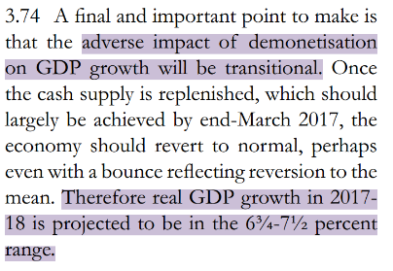
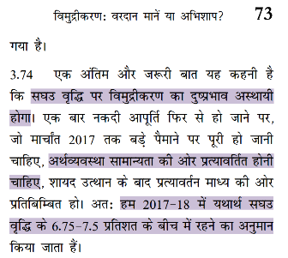
[सघउ वृध्धिदर!]Real GDP growth rate…(constant prices 2011-12)
Survey projection
Says CSO [31/5/17 release]

Slide 31


Sector’s “own” growth rate (%) GVA [at Constant price 2011]
Rs.100
2015
Rs. 104
2016
Agri Growth rate: 4%

Slide 32
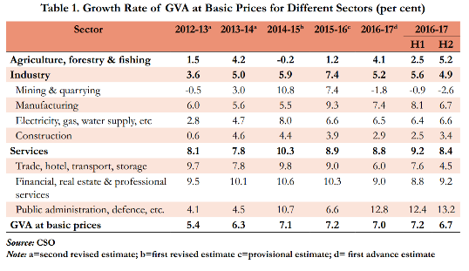


Agriculture, fishing, forestry GVA @Basic Prices [taxes, subsidies ignored]
Although afterwards CSO figures in 31/5/17 say this is 4.9% so performed better than expected. But ignore that latest Development for Prelims’17.

Slide 33


industries GVA @Basic Prices [taxes, subsidies ignored]
industries
Services

Slide 34
GDP: Gross Domestic Production
Meaning
Methods to Calculate
Demonetization: Effect?
Current price
Constant price
GDP deflator
Growth Rate
NNP
GNP

Slide 35
Gross Domestic Product (GDP) सकल घरेलू उत्पाद (2016)
Jaguar: £22.208 billion
Exploration: $22 billion
$68 million
GDP is the Market value of
All final goods & services
Produced within a country
For a given time period.
Rs.40 cr (2016)

Slide 36

Gross Domestic “Product”-> Gross National “Product” (GNP)
Add NET Factor income (WIPR) from abroad
Jaguar: £22.208 billion
Exploration: $22 billion
$68 million
++ WIPR
++Wages (e.g.Indian BoD), Interest, Dividend, Profit
++ Remittance, gift, donation
GDP is the Market value of
All final goods & services
Produced within a country
For a given time period.
-- Walmart
-- Suzuki
Rs.40 cr (2016)
-- Remittance

Slide 37
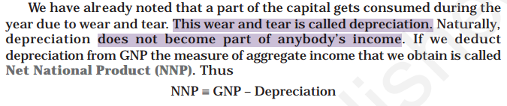

GDP + “NET” factor income from abroad
NET National
Product
(Market Price)
GNP
(-) Depreciation
NNP(FC)
=National
income
NNP
(MP)
- TAX
+Subsidies
Recall, FC -> MP by doing plus tax minus subsidies, then to go from MP to FC, change the signs.

Slide 38
Mock Question for Prelims
In the GDP calculation, to obtain factor cost from the market value, we’ve to:
Add subsidies and taxes.
Add taxes and remove subsidies
Add depreciation and remove taxes
Add subsidies and remove taxes

Slide 39
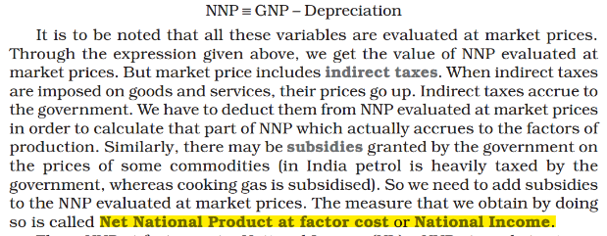
Prelim 1997
What is Net National Income? (1997)
Net Domestic Product at market price
Net Domestic Product at factor cost
NNP at market price
NNP at factor cost (right, NCERT Class12, Macro, Page24)
Although now CSO defines @MP. But When in doubt, NCERT wins.

Slide 40
CSO: Per capita Net National Income (@Market Price)

Slide 41
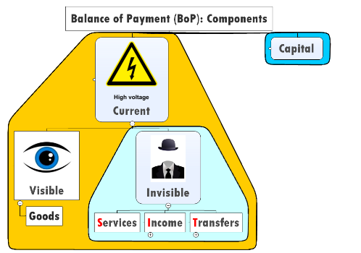
What is National “Disposable income”?
GDP + NET Factor income from abroad
Jaguar: £22.208 billion
Exploration: $22 billion
$68 million
++ WIPR
++Wages (e.g.Indian BoD), Interest, Dividend, Profit
++ Remittance, gift, donation
Rs.40 cr (2016)
-- Remittance

Slide 42
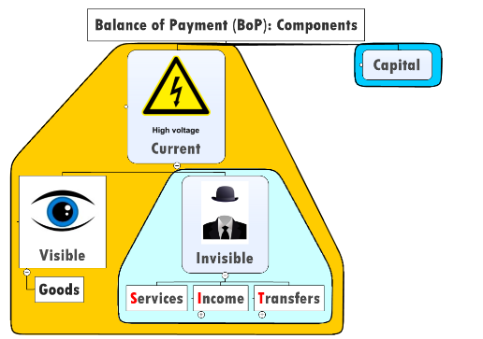
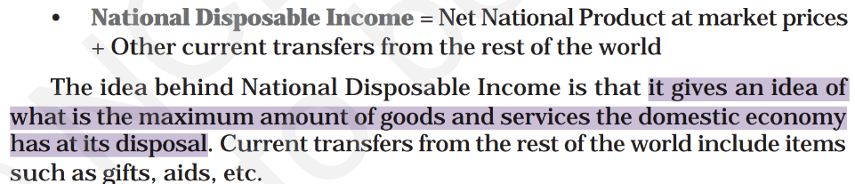
GDP + “NET” factor income from abroad
GNP
Depreciation
NNP (MP)
NET “other” Current Transfer: gift, aid..
National Disposable
income

Slide 43
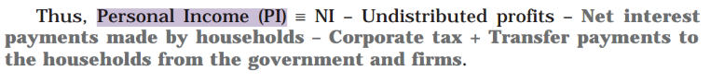
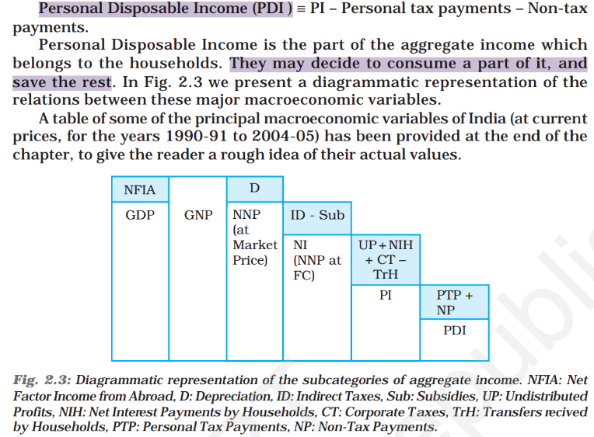
NCERT Class12 Macro
Ch. 2
If time then read
Else ignore.

Slide 44
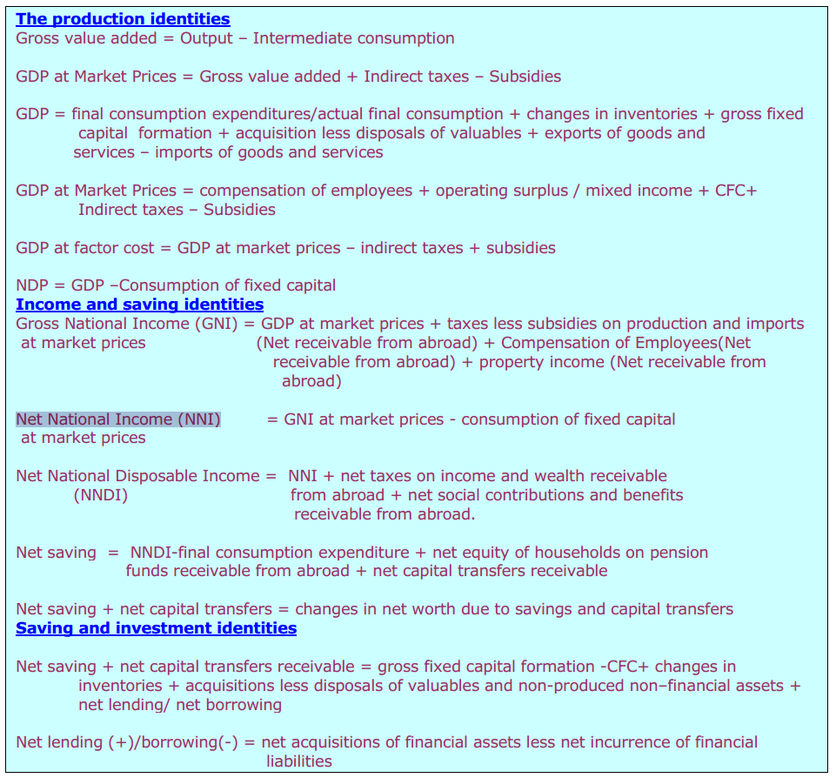
CSO’s real formulas are different.
But ignore for exams.

Slide 45
GDP: Gross Domestic Production
Meaning
Methods to Calculate
Demonetization: Effect?
Current price
Constant price
GDP deflator
Growth Rate
NNP
GNP

Slide 46




GDP growth: Demonetization (Notebandhi) की असर, the effect
SBN: 15 lakh cr.
Value wise 86% of currency notes
M
Money Supply
V
Velocity of Money
P
Price Level
(GDP Deflator)
Y
(Real GDP)
M
Money Supply
V
Velocity of Money
Nominal GDP
$$GDP deflator=\frac{Nominal GDP}{Real GDP}$$
Think of GDP Expenditure method: if someone produced, someone purchased.
Notes:
(each time used in transaction)
http://people.stern.nyu.edu/nroubini/NOTES/HAND6.HTM

Slide 47
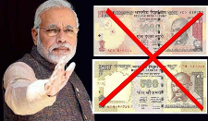
Effect of Demonetization? [Assume figures adjusted @constant prices 2011]
FY16 (2015-16)
Q1: 100
FY17 (2016-17)
Q1: 107
Quarterly growth rate for 2016-17
7%
7%
-10%
Q2: 100
Q3: 100
Q4: 100
Q2: 107
Q3: 90
Q4: 95
-5%
Negative growth rate in two successive quarters = RECESSION

Slide 48
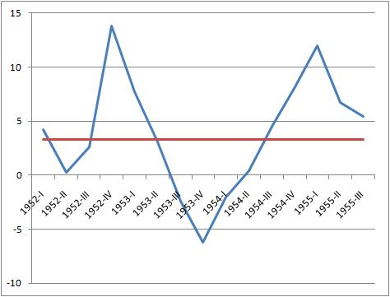
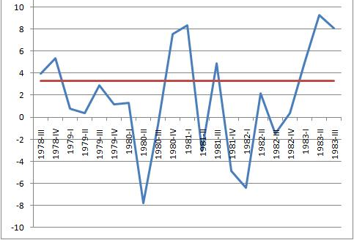
And some critiques (from you know which newspaper) were writhing in ‘excitement’
Negative growth rate in two quarters = recession
Double dip
One dip

Slide 49
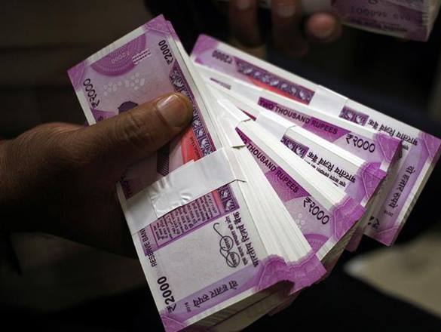
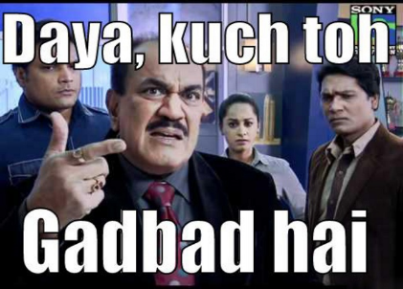
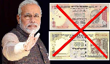
GDP growth: Demonetization (Notebandhi) की असर, the effect
Growth rate in 2016-17
compared to previous quarter in 2015-16
Unorganized and informal sector data not captured in CSO. So, it’ll not reflect (MIT Economists)
Can’t be this high!!

Slide 50
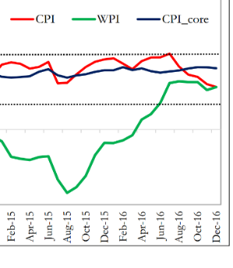



Hypothetical numbers, and Technically incorrect ofcourse…
 | Money supply (M) | x | Velocity (V) | = | Price level (Inflation) | x | Real GDP (Y) | fall
Q3-15 | 100 | x | 5 | = | 1.25 | X | 400 | 0
Q3-16 | 50 | x | 2* | = | 0.8 | X | 125 | -69%
But actually | 50 | x | 3.5 | = | 1.24 | X | 141.129 | -65%
*Critiques thought this would happen….
Cash withdrawl limits: people will spend very parsimoniously [कंजूसी से]
Rs.2000/- note: merchants not accepting for change problem.
Bank deposit▲, rural area: cheque, card, NEFT acceptance
Informal credit, bartering system and digital payments. So velocity, not ‘extremely’ down.
Some experts: ▲
Price levels remained “firm”, due to global crude oil prices ▲.
If inflation had completely fallen then large GDP fall
$$Y▼=\frac{M▼∗V(?)▼}{P \left(?\right)▼}$$

Slide 51

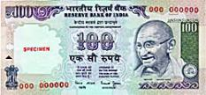
Let’s understand it in a much simpler manner. Suppose a coaching “sir” has Rs.100 as black money & Rs.100 note demonetized
Declare 100 as black money in PMGKY
Left Rs.50 only
- 50% [Tax + penalty]
Declare Rs. 100 as income from fake “new” admission & deposit
-15 as service tax (+KKC+SBC)
Rs. 85 left
30% income / corporation tax on that..
Left 42 rupees (officially) + 10+[15-2]=65 (in reality!)
Minus Rs.10: fake purchase chalk duster
60 Rs. “Taxable income / profit”
Minus Rs. 15: PMJDY as ‘fake salary’ to poor man (you keep Rs.2 as commission)

Slide 52
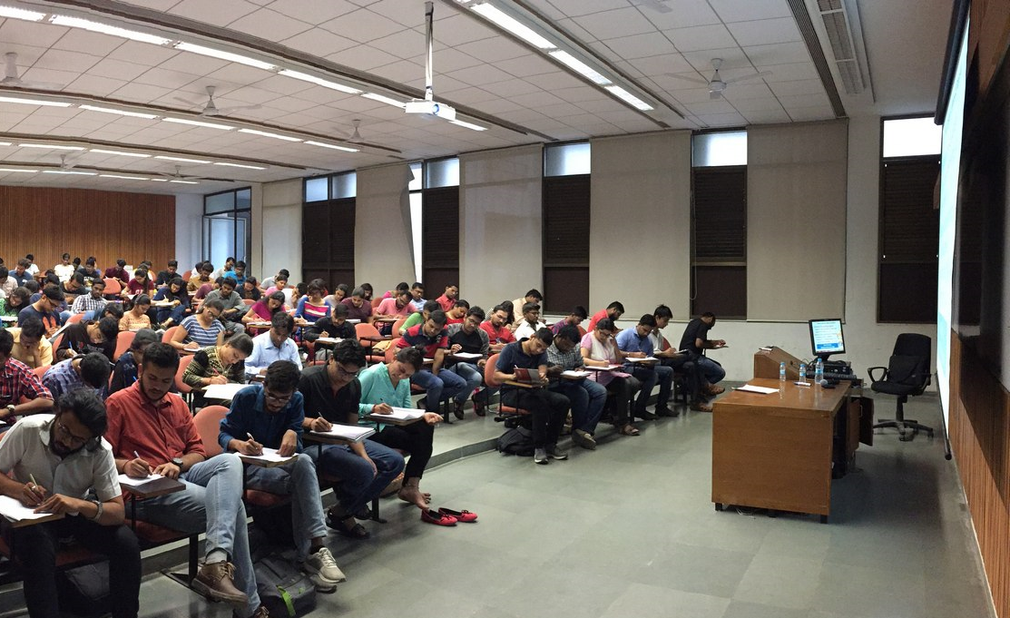
GDP (expenditure method) = Consumption + Investment + …+ (CIGXM)
Projector: Excise+VAT
[Investment]
Chair, Table
Excise+VAT
[Investment]
Indirect tax collection depending on how much fake invoicing/sales/purchase
Direct tax collection ought to rise [on how much profit/income “claimed”
GDP (expenditure method)
Admission = Service Tax
[Consumption]

Slide 53
Advance Tax: Indirect tax collection in Q3-2016 (lakh Cr.)
Option A:
Declare as Black Money
50% (Tax + penalty)
Option B:
Declare as fake sales, purchase, income
[direct, indirect tax] = still >50% left
Direct Tax collection
15% ▲
Indirect Tax collection
25% ▲

Slide 54
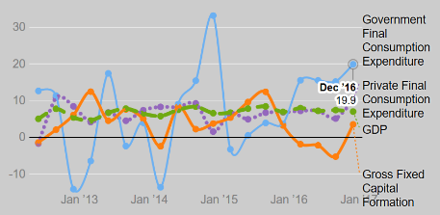
Expenditure method: GDP= C + I + G + (X – M)
Q3: Advance Tax collection rose. Meaning bizmen inflated earning to convert black to white.
+Consumption (Final)
+Government “Purchase”
Foreign Expenditure
(Export-Import)
+Investment
Projector, chair, table: steel, wood…inventories (++) advance tax collection
Also overstated / overinflated, says the critiques

Slide 55
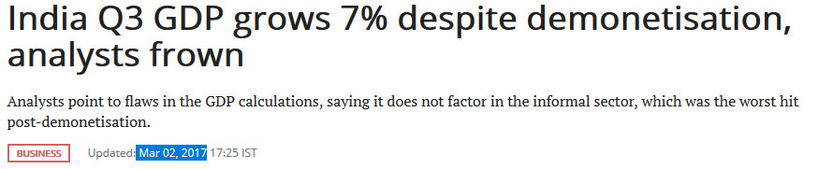



Many factors behind Q4 fall. Overall 7.1% is good!
Demonetization= “Short term challenge, Long term benefit.”
See! Demonetization hurt economy! Look @Q4 Growth Rate!
New GDP data came in 2nd / 3rd June 2017: I think UPSC Prelim paper already set. So not doing more analysis.
We’ll come back to this for Mains.
Growth rate Q4-2016
Jan-March’17 over Jan-March’16

Slide 56

2016
UPSC 2016
Prelims GS
38/100
Current Q.
2015
1
2
2
1
2
1
2
From an individual month, max 3 current MCQ
3
1
This accounts for 15/38 current Qs. Remaining- mostly from 2015
but difficult to ascertain date due to ‘continuous news’. And Some from 2014, 13
Notes:
Remaining MCQs were such that sporadically came everyone in while in newspaper, so difficult to fix month and date. But all in all, majority of the current affairs question were from last year (2015). And no more than 3 MCQs from any individual month.

Slide 57
2017
2016
?
?
?
?
?
?
It doesn’t mean UPSC examiners are “outdated”. But they’ve to take into account aspirants who’re from geographically and economically “distant” area. Current Affairs are imp. But 24/7 उसकी हाय-हाय मत करो.
?
?
?
?
?
?
?
?
?
?
On that logic…the “MAXIMUM LATEST” current Affairs for UPSC Prelim 2017: April…may be Max May W1 (well, still I’ve covered GST till then.)
If at all “backbreaking”: still max. may be 3 MCQs / per month- logic se… I’ve ignored latest developments of GDP, Trump’s Paris EXIT, GST ball by ball etc. and so on….to prevent your ‘study load and stress’ before prelims.

Slide 58



GVA
-SUBSIDIES (underestimate)
= Nominal GDP▲
+TAX (overestimate)
$$GDP Deflator=\frac{Nominal}{Real}$$
$$∴Real GDP=\frac{Nominal}{GDP Deflator}$$
Critiques of CSO
RajanBhai
CEA Arvind S.
Prof. Angus Deaton (Noble’15)
Taper Tantrum Crisis: still mfg. GVA was “shown”high. Not aligned with ground realities
Nominal/ GDP deflator | Real GDP @Constant Prices
110/1.2 | 91
110/1.1 (underest.) | 100
How GDP is overestimated

Slide 59

CSO updates GDP deflator quarterly.
GDP @Market Price
Growth rate over previous year
Inflation Price adjusted (GDP deflator)
GDP @Constant price
But we can’t use WPI, since 1) services inflation not counted 2) GDP final market value: ‘retail’ prices not wholesale ☹
But we can’t use CPI, since
Imported goods inflation counted. [difficult to remove]
Not all the goods-services produced, are consumed by ‘retail’ customers.
doesn’t count intermediate goods inflation, and assigns fixed weights to final goods/services irrespective of level of production.
GDP deflator doesn’t have the deficiency of WPI/CPI. That’s why we use GDP deflator.
PS: Remember: Inverse relation between Inflation vs real GDP Growth Rate. (hence WPI deflated GDP growth rate looks so high!)

Slide 60

But, why does CSO overestimate GDP or underestimate Deflator?
Lack of expert staff, faulty collection methods
Ruling party “success” of policies
BOND RATING
IMF: SDR Quota, Voting powers decided on GDP (Size of economy*)
FRBM: Fiscal deficit 3% of GDP, if GDP is large, govt gets more legroom for schemes

Slide 61

Criticism: 1) Demonetization effect capture ? 2) overestimated GDP 3) GDP doesn’t cover following:
Underground Economy
Non-Marketed Activities
Barter Exchanges
-ve Externality
Income Inequality
Opportunity cost
World Bank’s Gini coefficient
UNDP’s HDR: 5 index
90+0+0=90
30+30+30=90

Slide 62
If GDP doesn’t cover all these, then what to do? (2017, March)
UN World Happiness Day on March 20.
UN’s Sustainable Development Solutions Network (SDSN): index
GDP per capita
Healthy Life expectancy
Social support [friends, relatives helped?]
Generosity [did u donate money?]
Freedom to make life choices
Corruption Perception
GPSC: one exam cycle, & its litigation
5-10 years. ☹☹☹
Nakal-mafia in SSC-CGL & Bihar board exams ☹☹☹
1) Norway 2) Denmark
122) India [▼118]
China, BRICS , SAARC[!]
14) USA
155: CAR [most bogus in hunger, HDR report also]
But why is India so unhappy?
Notes:
Everyone wants to be IAS, but prelim fail = “freedom to make life choices (i.e. IAS)”
nhi hai ☹

Slide 63

Gross National Happiness
‘79: King coined the term
2008: Bhutan adopted the word in new Constitution as sort of “DPSP”
2016: Madhya Pradesh first state to setup Happiness Department, inspired from Bhutan. Prevent suicide, measure junta’s happiness with ministries
2017, June: Maharashtra also considering

Slide 64





Economy: 6 pillars + theory + current + BES17 (pre cum Mains)
1.Banking, Fin, Insur.
6.HRD
2.Budget
3.BoP
4.Sectors
5.Infra
V1:c3,4
V1:c2,3, 6,9,11(GST),13
V1c:5
V1c:7(Textile),11(trade)
V1c:10
v1c:12, 14; Budget^Rail
Up NEXT
CPI, WPI, IIP etc. index & Dem impact
GDP
11 pages bol-bachchan ► 12 slides
33 pages bol-bachchan ► 13 slides

